Slide 1
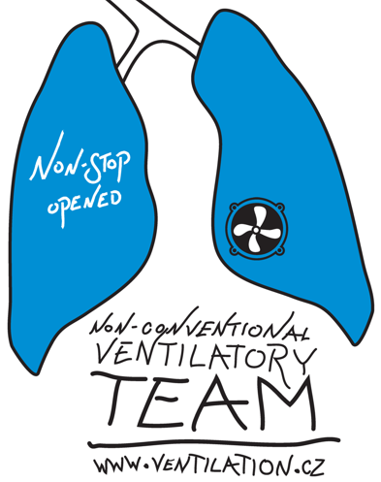

Healthy and ARDS model pigs during HFOV
Marianna Laviola, PhD
Czech Technical University in Prague
Faculty of Biomedical Engineering

Slide 2
INTRODUCTION – ARDS - Definition and Diagnosis
Acute respiratory distress syndrome (ARDS) is an acute severe lung disease commonly found in intensive care units
It is triggered by injury to the alveolar–capillary membrane from any of a variety of causes, resulting in fluid accumulation and acute respiratory failure
ARDS results in severe hypoxaemia, which is refractory to oxygen treatment and requires assisted ventilation
The severity of the condition was defined by the ratio of the arterial oxygen tension (PaO₂ measured in mmHg) to the inspiratory oxygen fraction (FIO₂), where room air is 0.21 and pure oxygen is 1.0
  Mild ARDS: 300mmHg > PaO₂/FIO₂ > 200 mmHg
  Moderate ARDS: 200mmHg > PaO₂/FIO₂ > 100 mmHg
  Severe ARDS: PaO₂/FIO₂ ≤ 100 mmHg
Ranieri VM et al., Acute respiratory distress syndrome: the Berlin definition. JAMA 2012

Slide 3
INTRODUCTION – ARDS - Pathogenesis
The triggering events are grouped into two classes: direct ‘pulmonary’ and indirect ‘extrapulmonary’ conditions:
Direct causes are: conditions that injure the lung parenchyma, pneumonia, pulmonary contusion due to trauma, aspiration and inhalation, or ingestion of toxic agents
Indirect insults are: severe sepsis, shock, overdose of certain drugs, disseminated intravascular coagulation and multiple blood product transfusions
Despite the variety of triggers, the resulting ARDS, in its later stages, shows a uniform clinical and pathological pattern
Rocco PR, Zin WA. Pulmonary and extrapulmonary acute respiratory distress syndrome: Are
they different? Curr Opin Crit Care 2005

Slide 4
INTRODUCTION – ARDS - Pathogenesis
The acute phase of ARDS is characterized by injury to the alveolar–capillary barrier, with disruption leading to increased permeability
Leukocytes accumulate in the pulmonary capillaries and invade the airspaces
Inflammatory vasoconstriction
Reduced compliance (greater ‘stiffness’) of the lungs
Atelectasis (collapse of alveoli rendering them airless) due to loss of the surfactant, reducing surface tension of the alveolar lining fluid
The consequent respiratory failure is aggravated by severe ventilation/perfusion mismatching, with some perfused alveoli no longer receiving any ventilation (‘shunt’), while others are ventilated but not perfused (‘dead space’)
Rocco PR, Zin WA. Pulmonary and extrapulmonary acute respiratory distress syndrome: Are
they different? Curr Opin Crit Care 2005

Slide 5
INTRODUCTION – ARDS - Treatment
Mechanical ventilation is major components of the treatment of ARDS as it keeps the patient alive and ensures gas exchange
High-frequency oscillatory ventilation (HFOV) can theoretically offer effective lung protective ventilation by:
  delivering very low tidal volumes (1 to 3 mL/kg) →helping prevent volutrauma caused by alveolar over-distension
  constant relatively higher, compared to conventional mechanical ventilation, continuous distending pressure (CDP) → improving oxygenation via improved alveolar recruitment
  smaller differences between inspiratory and expiratory pressures → preventing atelectotrauma associated with cyclical alveolar collapse and distension
  Lower peak pressures → reducing barotrauma
  Ventilation is inversely related to the respiratory frequency and is directly related to the excursion of the diaphragm, the latter expressed as the pressure amplitude of oscillation
  By maintaining a CDP, HFOV facilitates CO₂ elimination mainly by accelerating the molecular diffusion processes
Downar J, Metha S. Bench-to-bedside review: High-frequency oscillatory ventilation in adults with acute respiratory distress syndrome. Critical Care 2006

Slide 6
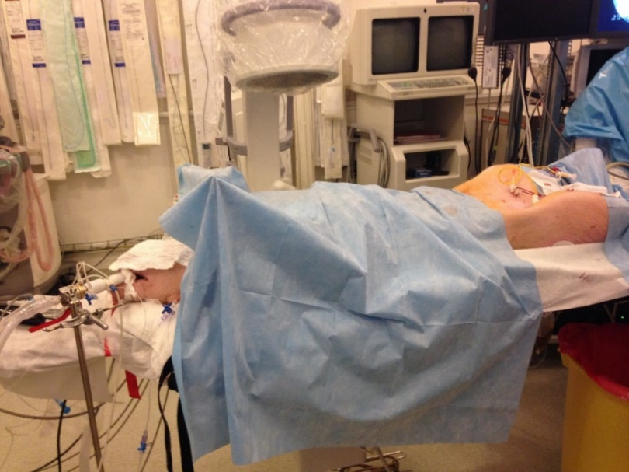
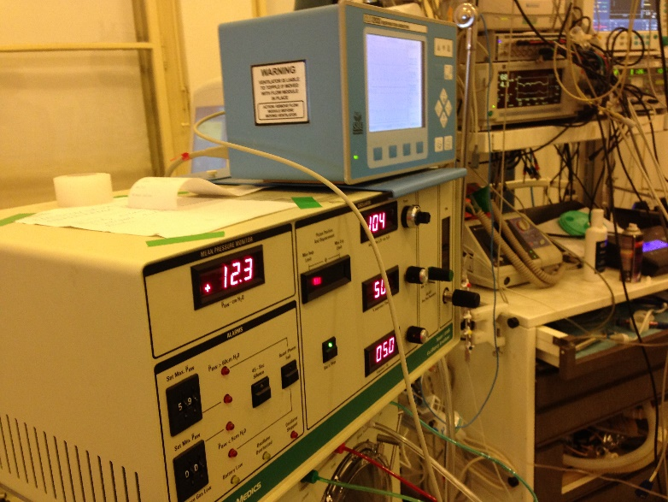
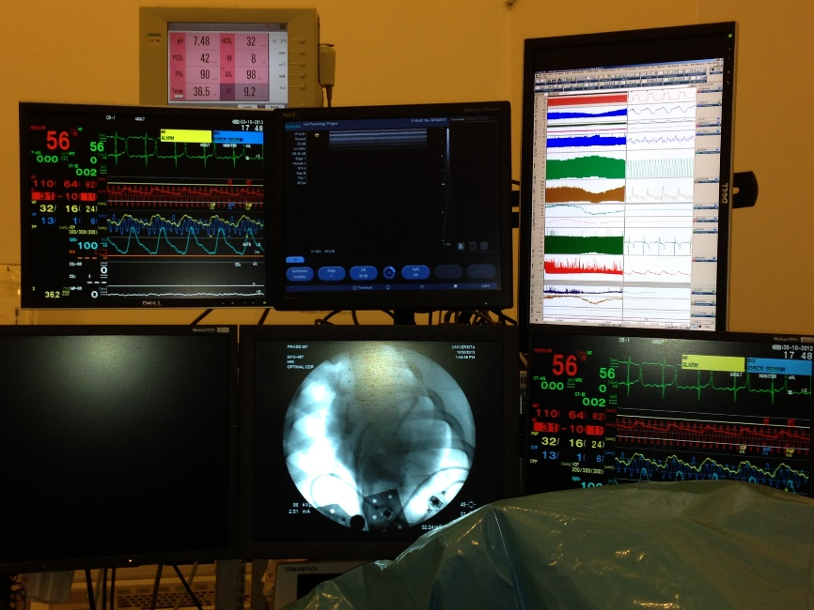
Material and Methods

Slide 7
Material and Methods
Conventional ventilation - Hamilton G5
Non conventional ventilation: HFOV - SensorMedics 3100B HFO ventilator
Arterial blood gases, i.e. partial pressure of oxygen (PaO₂), carbon dioxide (PaCO₂) and pH measured by CDI 500
Arterial blood (ART), central venous (CVP) and femoral (FEM) pressures were monitored by Nihon
Cardiac output (CO), mixed venous blood oxygen saturation (SvO₂) and pulmonary artery pressure (PAP) measured continuously by Vigilance
All signals were synchronously recorded using a LabChart system

Slide 8
Material and Methods – Devices, parameters and sampling frequency
CDI Terumo 500
pH, PaO₂, PaCO₂, Temp, HCO3, BE, K+ fs=0.1675 Hz
Nihon
CDP fs=125Hz
ART, CVP, FEM pressures fs=125 Hz
ECG fs=250 Hz
Labchart
AW pressure (CDP), PV loop, CO and SvO₂ (from Edwards Life science)
All signals fs=400 Hz
Datex
CDP, etO₂ and etPaO₂ fs= 100Hz

Slide 9
Material and Methods – Protocol
Healthy Pigs
Initial CDP= 10±2cmH2O
Ascending steps: steps of 2cmH2O
Maximum CDP= 32±5cmH2O
Descending steps: steps of 2cmH2O to initial value
ARDS model pig
(after one or two lavages with saline solution with nonionic surfactant)
Initial CDP= 17±4cmH2O
Ascending steps: steps of 2cmH2O
Maximum CDP= 43±6cmH2O
Descending steps: steps of 2cmH2O to initial value

Slide 10
The relationship between parameters determining the body oxygenation during CDP maneuvers in porcine models of healthy and ARDS lungs on HFOV

Slide 11

Body oxygenation during CDP steps
SvO₂ is the percentage of hemoglobin saturated with oxygen in the venous blood that returns to the right side of heart
It is the oxygen reserve and can help to determine whether the cardiac output and oxygen delivery is high enough to meet individuals’ needs
We implemented a linear model that reflects how PaO₂ and CO affect the body oxygenation, in the means of SvO₂ in healthy and ARDS lung model pigs
Aims of study
to find out whether courses of SvO₂ can be expressed as a linear combination of courses of PaO₂ and CO
to investigate the effects of changes in CDP upon the weights describing contributions of PaO₂ and CO upon SvO₂ courses

Slide 12
Results – Healthy model
r²=0.69
MSE=2.22
r²=0.40
MSE=3.33

Slide 13
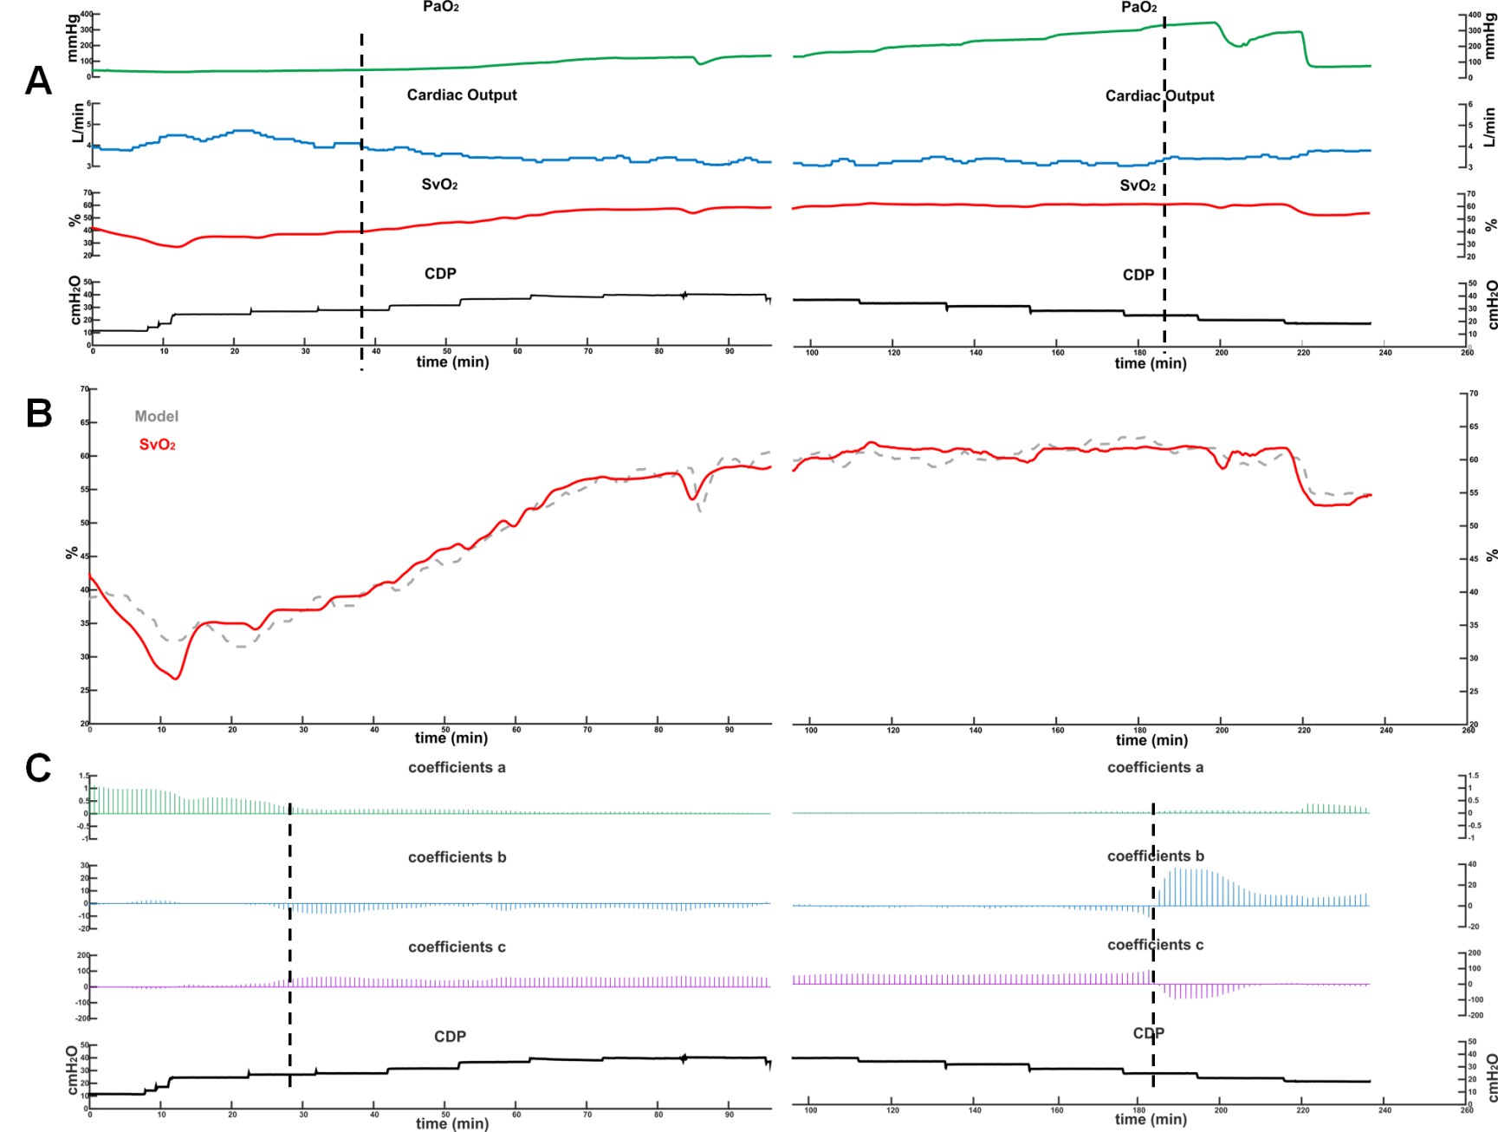
Results – ARDS model
r²=0.95
MSE=5.08
r²=0.68
MSE=2.34

Slide 14
Conclusions
The model implemented has a good fitting, indeed the r² of model are high and its standard errors are low for all animals considered
There are two certain levels of CDP at which contributions of PaO₂ and CO to SvO₂ course change their weights: one for the ascending and one for the descending steps
For values of CDP higher than these, PaO₂ plays a major role in SvO₂ course, preventing that it decreases such as CO
In the ARDS model, the CDP level is higher than in healthy lung model: pigs required a much higher CDP during HFOV to maintain an adequate oxygenation:
Trends: ascending steps: 28.1±5.8cmH₂O vs 19.1±3.3cmH₂O, p<0.001; descending steps 28.5±5.2cmH₂O vs 20.8±4.cmH₂O, p=0.034
Model: ascending steps: 28.6±5.5cmH₂O vs 17.3±4.3cmH₂O, p<0.001; descending steps: 30.4±6.5cmH₂O vs 19.1±3.0cmH₂O, p=0.005
There might be a relation with the fact that the CDP should be higher for ARDS lungs than in normal lungs so that HFOV is effective

Slide 15
Models of a PaO₂ course during a stepwise change of Continuous Distending Pressure in HFOV

Slide 16
Model of PaO₂ during CDP steps in HFOV
The response of PaO₂ to a change in CDP can vary significantly not only in amplitude but also in its shape
The PaO₂ shape could response to the sudden change in CDP depending on the target of CDP level
Aim of study
is to investigate if the level of CDP affects the shape of the PaO₂ response of the organism to the CDP stepwise changes

Slide 17
Model of PaO₂ during CDP steps in HFOV
Power model
y=a x ^{b}
where x is the length of CDP in terms of time, a is the amplitude of model, exponents b reflects the shape of model.
If b = 0 ÷ 1, PaO₂ follows a root function respect to time, e.g. a square root when b=0.5;
If b =1, PaO₂ follows a linear function respect to the time;
If b =1÷2, PaO₂ follows a function between linear and quadratic respect to the time;
If b =2, PaO₂ follows a quadratic function respect to the time;
If b 2÷ 3 PaO₂ follows a function between quadratic and cubic respect to the time.
For all other values of b, e.g. PaO₂ course is constant, we set b=0

Slide 18
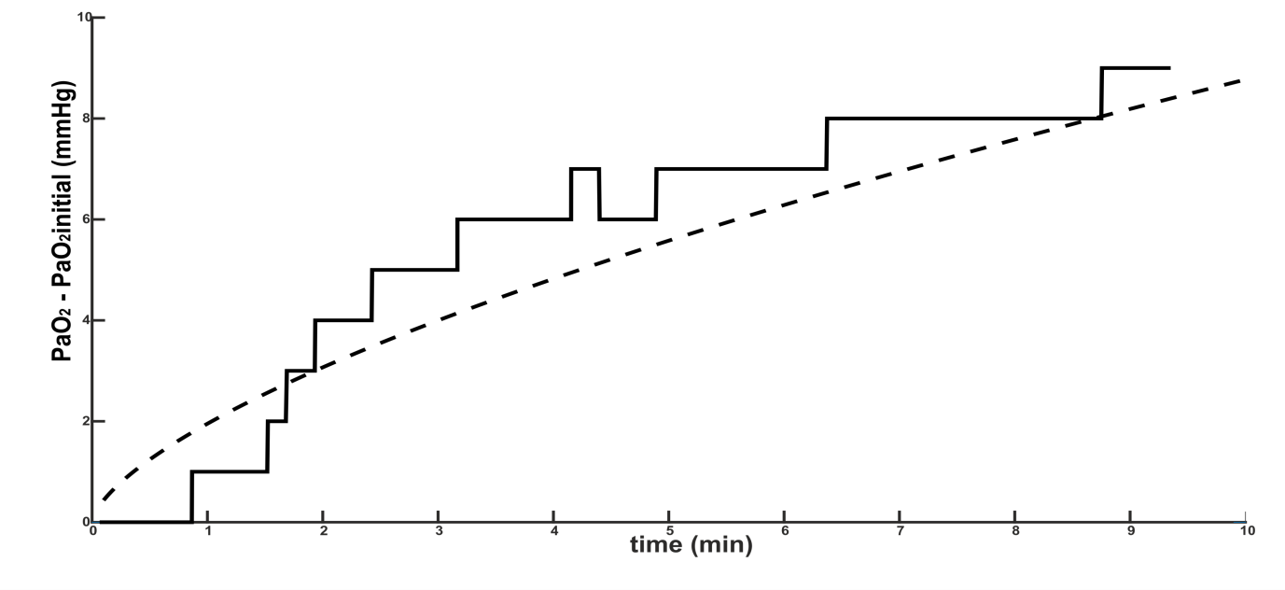
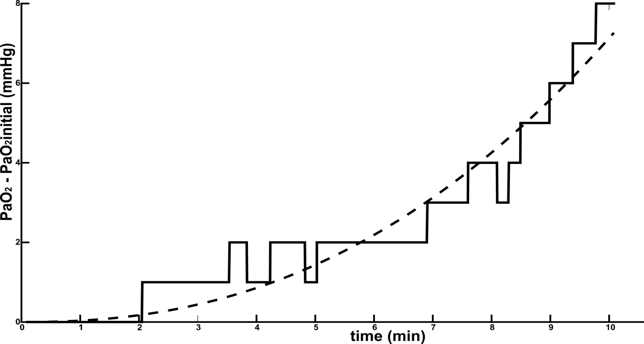
Shape of PaO₂
a=1.95; b=0.65
r²=0.92; RMSE=0.79
a=0.035; b=2.31
r²=0.98; RMSE=0.57

Slide 19
Results: ascending steps

Slide 20
Results: descending steps

Slide 21
Results: ascending steps

Slide 22
Results: descending steps

Slide 23
`Conclusions
During both the ascending and the descending of CDP steps, the PaO₂ course follows several shapes that can modelled mainly by: constant, root, linear and quadratic functions
For values of PaO₂<200mmHg the course of PaO₂ follows a shape can be modelled by a root function, but also by linear and/or quadratic functions
For values of PaO₂>200mmHg the course of PaO₂ follows a shape can be modelled exclusively by a root function
It is not possible to determine a relationship between the shape of PaO₂ response and the values of CDP

Slide 24
`Conclusions
When alveoli are not recruited at all or have not been fully recruited yet, oxygenation is more sensitive to changes in lung volume and aeration
→ PaO₂ grows or drops rapidly following linear and/or quadratic functions
When alveoli are open and recruited, changes in PaO₂ are less sensitive to relatively minor changes in lung aeration
PaO₂ grows and drops slower following only root function
The recruitment might occur at different values in each pig, and so, absolute value of CDP does not provide information about the recruitment
.

